Slide 1
Social Computing in CoFM
Version 0.1
2012-5-1

Slide 2
What is Social Computing
Supporting “computations” that are carried out by groups of people --- James Surowiecki. The Wisdom of Crowds [Book] 2004. (Cite count: 3400+)

Slide 3
The Group
Four elements required to form a wise crowd
Criteria | Description
Diversity of Opinion | Each person should have personal opinion even it's eccentric.
Independence | People's opinions aren't determined by the opinions of those around them.
Decentralization | People are able to specialize.
Aggregation | Some mechanism exists for turning private judgments into a collective decision.
The Wisdom of Crowds

Slide 4
The Computation
Typical Computations
Collaborative filtering (Recommender system)
Reputation system (Explicit rating/voting by users)
Tagging

Slide 5
Related Work on Feature Models
ICSE ‘12. Horatiu Dumitru et al. On-demand feature recommendations derived from mining public product descriptions.

Slide 6
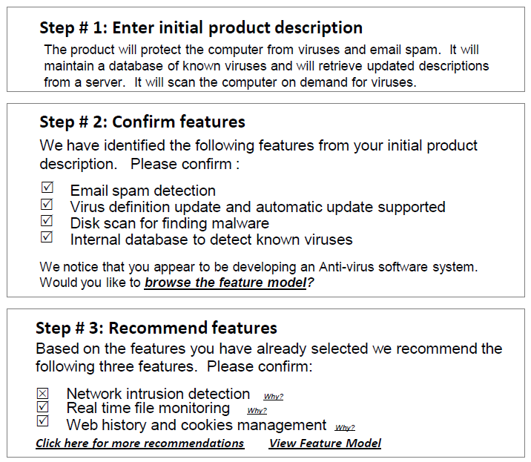
Example Usage
Not in the paper!

Slide 7
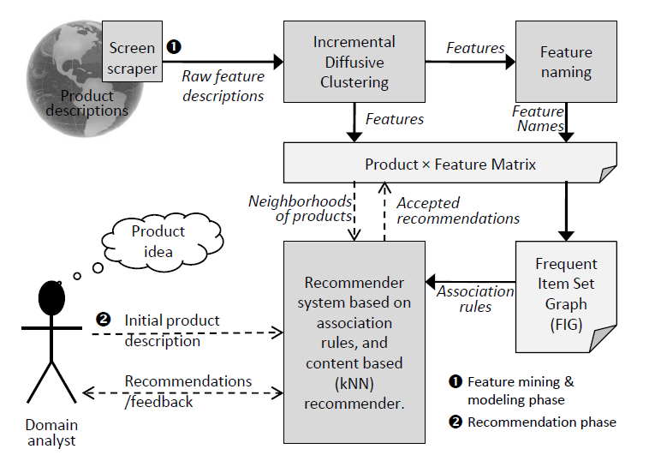
Overview

Slide 8
Raw Description → Feature
Raw descriptions come from Softpedia.com
796,536 products, over 1.5 billion downloads
292 domains (August, 2010)
Clustering in each domain
Merge clusters over all domains (Cluster similarity > 0.6)
Feature Name = Center Raw Description (Medoid)
Medoid

Slide 9

New Product Description → Recommended Features
Product-Feature Matrix: 0-1 Matrix
Does a product contain a feature?
New Product Description
k-Nearest Neighbors Algorithm
Neighbor Products
Standard Collaborative Filtering
Recommended Features

Slide 10
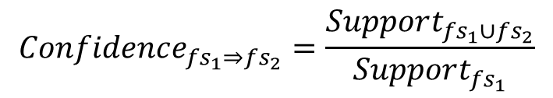
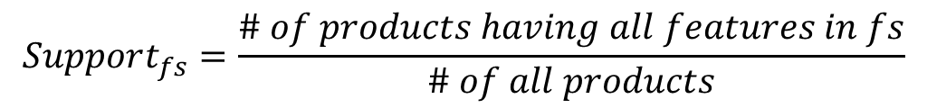
Current Features → More Features
Support of a feature set
Confidence of a feature set association (Add a feature set to another)
Repeat
Current Features = fs₁
fs₂ is a single feature (Add 1 more feature each time)
$$Support_{fs}=\frac{\# of products having all features in fs}{\# of all products}$$
$$Confidence_{fs_{1}⇒fs_{2}}=\frac{Support_{fs_{1}∪fs_{2}}}{Support_{fs_{1}}}$$

